Slide 1
Writing and Citation
ITSC 201 & Comm 256
Autumn 2019
Stu White

Slide 2
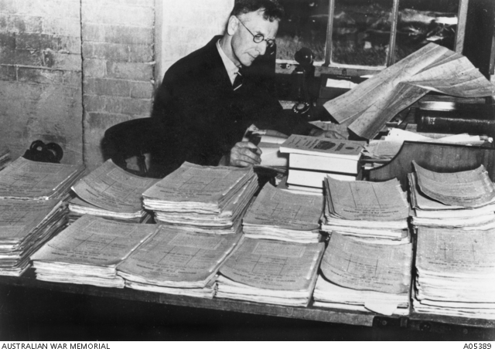
What’s all This Then?
How Many Essays?
3 Short
2 Pair or Group
1 Reflective
1 Take Home Essay
What Percentage?
90% of ITSC 201
Captain CEW Bean [Online Image]. (Early 20th Century). Retrieved September 5, 2018 from https://www.awm.gov.au/collection/P10676229

Slide 3
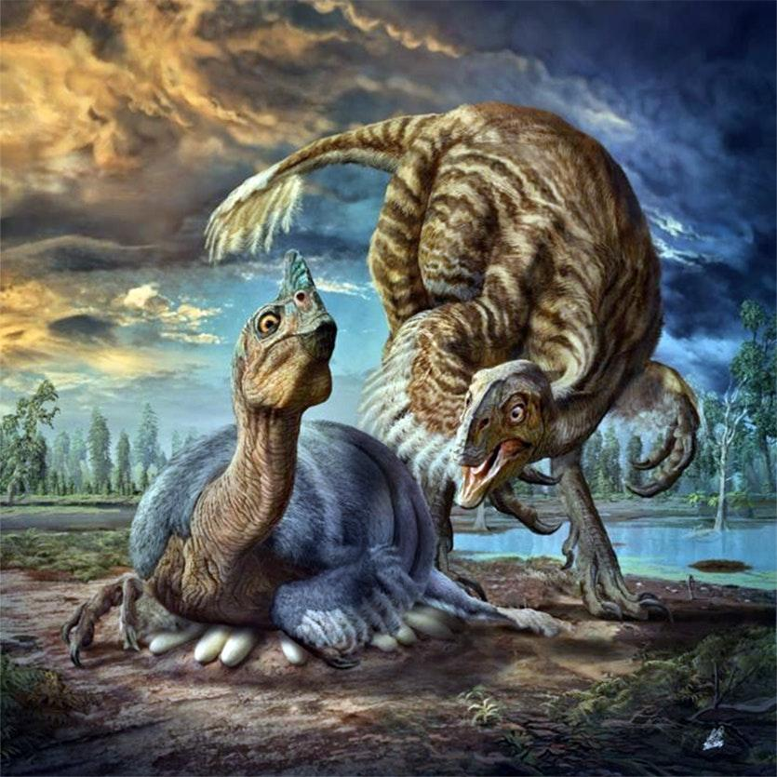
Expectations
Strategic Studies
Clear
Well Argued
Accurately Cited
Communications 256
Clear
Well Formatted
Accurately Cited
Oviraptor Brooding [Online Image]. (May 2017). Retrieved September 5, 2018 from https://cosmosmagazine.com/palaeontology/new-giant-oviraptor-dinosaur-species-the-biggest
-find-yet

Slide 4
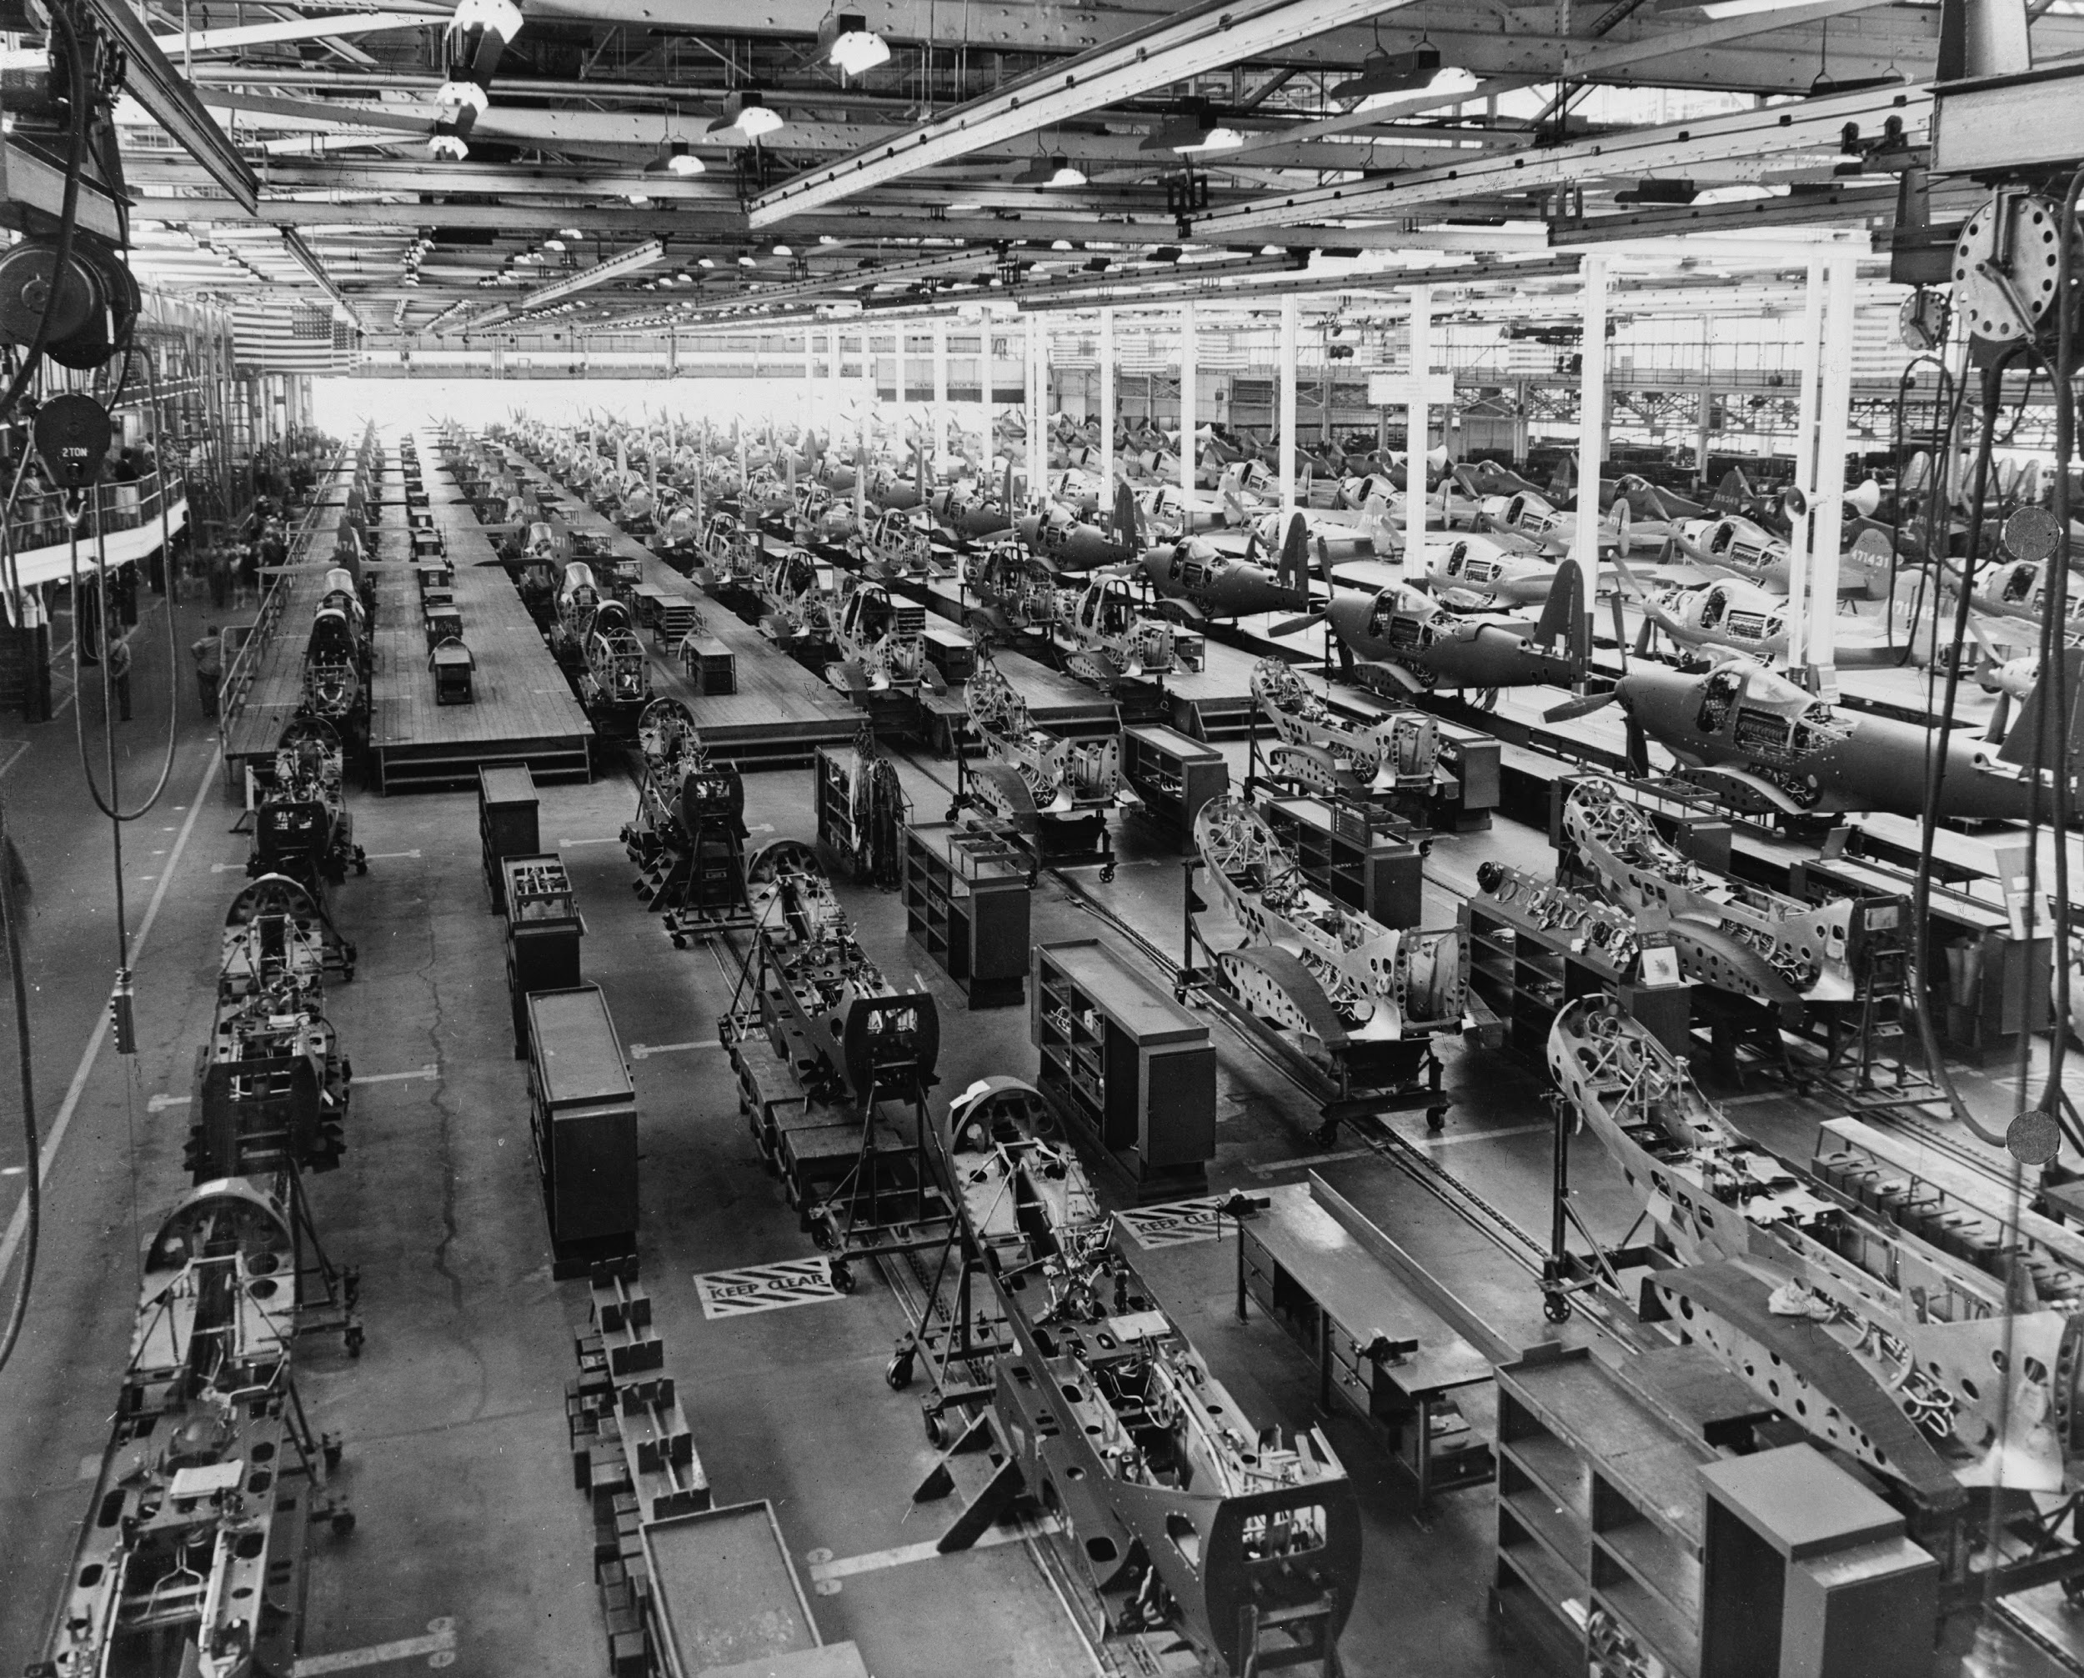
The Process
Research Question
Notes
Thesis
Outline
Draft
Redraft
Polish
Submit
Celebrate
P 39 Production [Online Image]. (1940-1946). Retrieved September 5, 2018 from
https://commons.wikimedia.org/wiki/File:Airacobra_P39_Assembly_LOC_02902u.jpg

Slide 5
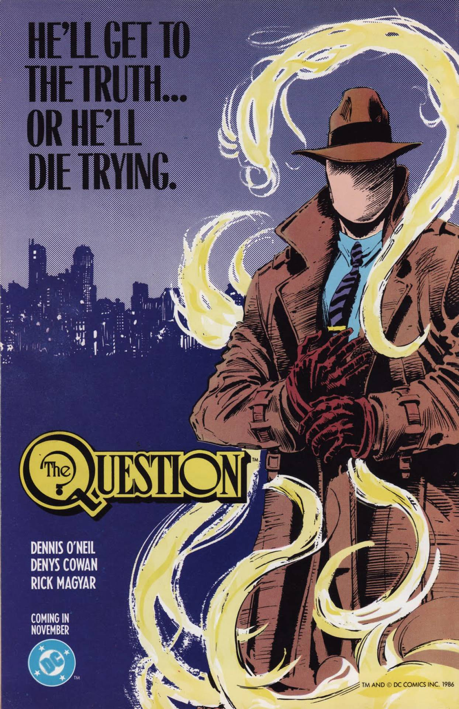
The Process 1: Research Question
Research Question
Notes
Thesis
Outline
Draft
Redraft
Polish
Submit
Celebrate
The Question [Online Image]. (July 26, 2018). Retrieved September 5, 2018 from https://comicvine.gamespot.com/the-question/4050-3805/

Slide 6
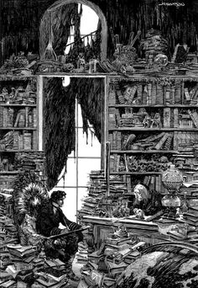
The Process 2: Research and Notes
Research Question
Notes
Thesis
Outline
Draft
Redraft
Polish
Submit
Celebrate
B. Wrightson [Online Image]. (July 26, 2018). Retrieved September 5, 2018 from
http://berniewrightson.com/galleries/

Slide 7
The Process 3: Thesis
Research Question: Was John F. Kennedy a good president?
Weak:
Because of his youth, great hair, and excellent choice in mistresses, John F. Kennedy was a superb president.
Research Question
Notes
Thesis
Outline
Draft
Redraft
Polish
Submit
Celebrate

Slide 8
The Process 3: Thesis
Research Question: Was John F. Kennedy a good president?
Weak:
I think that John F. Kennedy was totally frigging awesome.
Research Question
Notes
Thesis
Outline
Draft
Redraft
Polish
Submit
Celebrate

Slide 9
The Process 3: Thesis
Research Question: Was John F. Kennedy a good president?
Improving:
In his presidency, John F. Kennedy led the U.S. through problems at home and abroad, and is thus one of the best presidents.
Research Question
Notes
Thesis
Outline
Draft
Redraft
Polish
Submit
Celebrate

Slide 10
The Process 3: Thesis
Strong:
During his short presidency, John F. Kennedy guided the United States through severe foreign policy crises and laid the groundwork for the progressive political agenda of the 1960s, thus securing his place as one of the finest leaders in American history.
Research Question
Notes
Thesis
Outline
Draft
Redraft
Polish
Submit
Celebrate

Slide 11
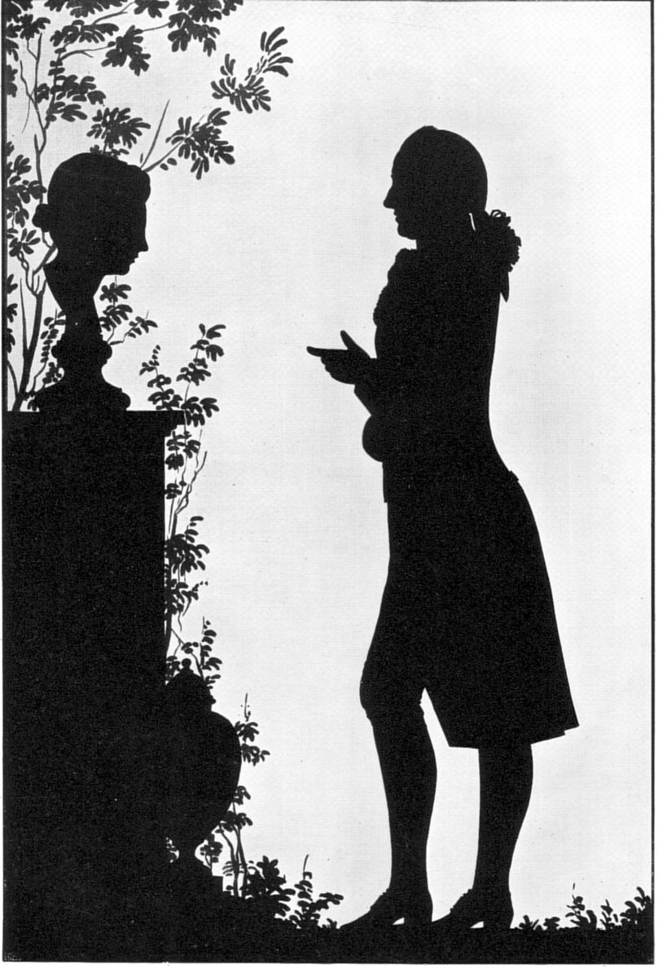
The Process 4: Outline
Research Question
Notes
Thesis
Outline
Draft
Redraft
Polish
Submit
Celebrate
Scherenschnit Portrait of Goethet [Online Image]. (1780) Retrieved from
https://commons.wikimedia.org/wiki/File:GoetheVorEinemGrabmalMitWeiblicherBuesteS92.jpg

Slide 12
The Process 4: Outline
Introduction
Thesis
Body
Argument 1
Evidence A
Evidence B
Argument 2
Argument 3
Conclusion
Thesis Restated
Research Question
Notes
Thesis
Outline
Draft
Redraft
Polish
Submit
Celebrate

Slide 13

The Process 5: Draft
Research Question
Notes
Thesis
Outline
Draft
Redraft
Polish
Submit
Celebrate
Bill Waterson [Online Image]. (1990s) Retrieved September 5, 2018 from
https://williamlobb.com/writing/calvin-writing/

Slide 14
The Process 5: Draft
Draft the body first
Then the introduction and conclusion
Amend the outline where necessary
Cite sources as you go
Research Question
Notes
Thesis
Outline
Draft
Redraft
Polish
Submit
Celebrate

Slide 15
The Process 5: Citations
Citations
Need to conform to the APA 6th Edition. You can use the Pudue Owl for online reference.
https://owl.purdue.edu/owl/research_and_citation/apa_style/apa_style_introduction.html
Research Question
Notes
Thesis
Outline
Draft
Redraft
Polish
Submit
Celebrate

Slide 16
The Process 5: Citations
You need to cite:
1 A direct quotation
2 A paraphrase
3 An idea drawn from a source
4 If in doubt, ask
Research Question
Notes
Thesis
Outline
Draft
Redraft
Polish
Submit
Celebrate

Slide 17
The Process 5: Citations
Why Do You Need to Cite?
1 To Assign Credit
2 To Permit An Audit of Your Work
3 To Help Readers Understand the Genesis of Your Ideas
4 To Guide Future Scholars
Research Question
Notes
Thesis
Outline
Draft
Redraft
Polish
Submit
Celebrate
Temple University. Citing sources: Why cite? (August 14, 2018) Retrieved September 5, 2018 from http://guides.temple.edu/citingsources

Slide 18
The Process 5: Citations
For example: As Thucydides (1996) noted in the Melian Dialogue, “the strong do what they can and the weak suffer what they must” (352).
However, paraphrased or summarized work also requires a citation. Thucydides (1996) used the interactions between Athens and Melos to underscore the moral bankruptcy of the Athenian argument that power, and not ethics or laws, protected states from abuse (352-354).
Research Question
Notes
Thesis
Outline
Draft
Redraft
Polish
Submit
Celebrate

Slide 19
The Process 5: Citations
In these classes, citations require:
1 Author
2 Date
3 Page numbers
For example: As Thucydides (1996) noted in the Melian Dialogue, “the strong do what they can and the weak suffer what they must” (352).
Research Question
Notes
Thesis
Outline
Draft
Redraft
Polish
Submit
Celebrate

Slide 20
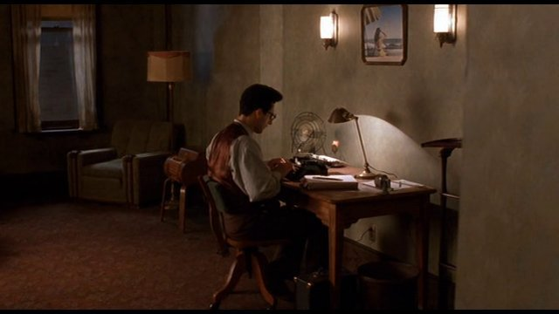
The Process 6: Redraft
Research Question
Notes
Thesis
Outline
Draft
Redraft
Polish
Submit
Celebrate
Barton Fink [Online Image]. (1990) Retrieved September 5, 2018 from
https://lowewords.wordpress.com/2015/03/30/wrestling-scenarios-and-other-things-literary-how-barton-fink-compelled-me-toward-the-life-of-the-mind/

Slide 21
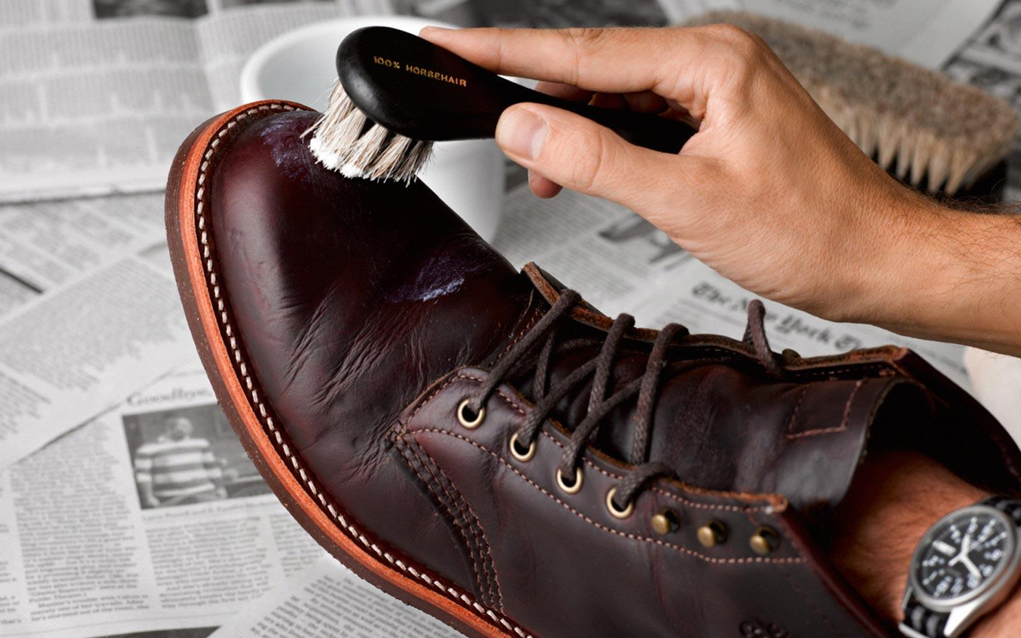
The Process 7: Polish
Research Question
Notes
Thesis
Outline
Draft
Redraft
Polish
Submit
Celebrate
Shoe Shining [Online Image]. (nd) Retrieved September 5, 2018 from
https://www.ties.com/blog/how-to-shine-shoes

Slide 22
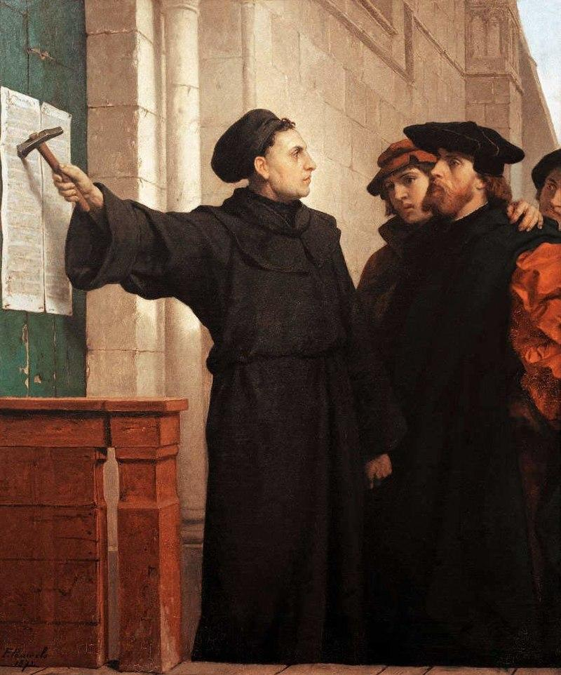
The Process 8: Submit
Research Question
Notes
Thesis
Outline
Draft
Redraft
Polish
Submit
Celebrate
Ferdinand Pauwels [Online Image]. (1872) Retrieved September 5, 2018 from
https://commons.wikimedia.org/wiki/File:Ferdinand_Pauwels_-_Luther_hammers_his_95_theses_to_the_door.jpg

Slide 23
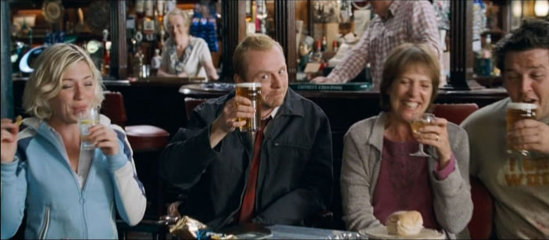
The Process 9: Celebrate
Research Question
Notes
Thesis
Outline
Draft
Redraft
Polish
Submit
Celebrate
Shaun of the Dead [Online Image]. (June 2014) Retrieved September 5, 2018 from
https://lazyfilmblog.wordpress.com/2014/06/03/shaun-of-the-dead/

